Slide 1
Health inequities in infection prevention and control in health care settings
June 2024

Slide 2
Inequities in health care also lead to inequities in infection prevention and control
The quality of healthcare delivery is segregated along racial and ethnic lines
2018 National Healthcare Quality and Disparities Report, Black, Hispanic, American Indian/Alaska Native, and Native Hawaiian/Pacific Islander patients were reported to receive worse care than White patients for 35–40% of quality measures evaluated
Source: https://www.ncbi.nlm.nih.gov/pmc/articles/PMC8390539/

Slide 3
Social Determinants of Health
Social determinants of health (SDOH) are defined as the nonmedical factors that influence health outcomes including (but not limited to) education quality, economic stability, neighborhood, housing environment, and healthcare access.
Source: Infection Control & Hospital Epidemiology , Volume 45 , Issue 4 , April 2024 , pp. 412 – 419; DOI: https://doi.org/10.1017/ice.2024.7

Slide 4
Example of a SDOH
Literacy levels may affect a patient’s ability to understand medical information and this may affect their decision making on proper wound care, adhering to antibiotic prescription use, nutritional guidance, etc.
More than 80 million American adults have low health literacy, with disproportionately higher representation among older adults and people from racially and ethnically minoritized backgrounds.
Source: Infection Control & Hospital Epidemiology , Volume 45 , Issue 4 , April 2024 , pp. 412 – 419; DOI: https://doi.org/10.1017/ice.2024.7

Slide 5
Mistrust may affect care
“Several historical medical mistreatment events, such as the US Public Health Service–funded study of untreated syphilis in Black men at the Tuskegee Institute, the unauthorized retrieval and profits from the use of Mrs. Henrietta Lacks’ cervical cells without her consent, and the compulsory sterilization of Native American women at Indian Health Services hospitals have created generations of mistrust for populations whose ancestors were harmed by these actions.”
Source: Infection Control & Hospital Epidemiology , Volume 45 , Issue 4 , April 2024 , pp. 412 – 419; DOI: https://doi.org/10.1017/ice.2024.7

Slide 6
Question for class discussion
How likely are you to follow the advice of a physician or nurse who you do not trust?

Slide 7
Language matters in outcomes
Inadequate options to appropriately communicate with individuals with limited English proficiency also compromise health literacy and negatively influence outcomes for those patient populations.
Individuals with limited English proficiency experience barriers to accessing healthcare coverage, which may delay treatment seeking and the receipt of appropriate care.
Source: McGrath, CL, Bettinger, B, Stimpson, M, et al. Identifying and mitigating disparities in central-line–associated bloodstream infections in minoritized racial, ethnic, and language groups. JAMA Pediatr 2023;177:700–709

Slide 8
Language barriers lead to health care barriers
These inequities likely have major downstream effects, including longer emergency room visits and hospital admissions in pediatric and adult patients who speak a language other than English.
Differences in infection prevalence, due to language barriers, have also been observed among pediatric populations.
Higher rates of central-line–related bloodstream infections (CLABSIs) have been documented in pediatric patients with limited English proficiency
Source: McGrath, CL, Bettinger, B, Stimpson, M, et al. Identifying and mitigating disparities in central-line–associated bloodstream infections in minoritized racial, ethnic, and language groups. JAMA Pediatr 2023;177:700–709

Slide 9
Question for class discussion
What languages do you often see printed in your area?
Do you often hear other languages that are not English?
If you hear languages besides English, how do your local hospitals and clinics communicate with these patients? Do they use interpreters? Online services? Phone services? Do you see materials printed in their language?
How are these services covered financially?

Slide 10
These inequities can also affect the health care staff
“People from racially or ethnically minoritized backgrounds were more likely to work in lower-income healthcare personnel roles (eg, certified nursing assistants and medical assistants) and were at higher risk of contracting COVID-19 due to presumed increased exposures in either or both work and nonwork settings.”
Source: Zlotorzynska, M, Chea, N, Eure, T, et al. Residential social vulnerability among healthcare personnel with and without severe acute respiratory coronavirus virus 2 (SARS-CoV-2) infection in five US states, May–December 2020. Infect Control Hosp Epidemiol 2024;45:82–88.

Slide 11
Actions taken to address the inequities
In June 2020, the Association for Professionals in Infection Control and Epidemiology (APIC)called for the need to address institutional racism, again citing the recent COVID-19 effects on marginalized communities.
APIC convened a Health Inequities and Disparities (HI&D) Task Force to create actionable recommendations
Source: https://www.ajicjournal.org/article/S0196-6553%2822%2900756-8/pdf

Slide 12
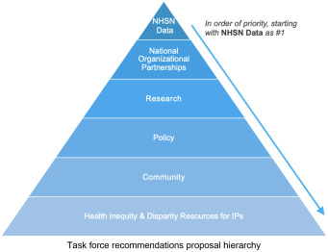
Task force created 6 recommendations

Slide 13
First recommendation from APIC task force
#1 Begin by making Ethnicity and Race required fields in NHSN (National Healthcare Safety Network is the nation's most widely used healthcare-associated infection tracking system.)
Question for class discussion: How does better data improve decision making?

Slide 14
Why data changes are needed
The National Healthcare Safety Network (NHSN) captures HAI and antimicrobial use data from acute and post acute care facilities.
HAI case reporters can include race and ethnicity data, but the field is optional. The antimicrobial use module captures only aggregate facility-level or unit-level information.
Although this information may be helpful to assess facility-level interventions, analysis of disparities in care or prescribing based on age, gender, race, or ethnicity cannot be performed.
Source: https://www.cambridge.org/core/journals/infection-control-and-hospital-epidemiology/article/advancing-health-equity-through-action-in-antimicrobial-stewardship-and-healthcare-epidemiology/E500CD36798BF6BF7661F5223E4AFDF6

Slide 15
Recommendations 2-4
#2 Develop new and/or leverage partnerships with agencies or organizations which are also addressing HI&D.
#3Create HI&D research grants for members and member allies (organizations and/or community groups)
#4 Impact and shape health disparities policy by partnering with public representatives and/or agencies such as the Centers for Medicare and Medicaid Services and The Joint Commission.

Slide 16
Fifth recommendation
#5 Intervening at the community level
Direct funds to community groups to perform pertinent research or an initiative to eliminate disparities
Create of community forums through health departments to allow for direct partnership with the community, and/or developing multilingual, multimodal patient education resources aimed at providing accessible information to patients in easy to consume formats.
Leverage relationships to launch educational campaigns, vaccine pushes, among other initiatives.

Slide 17
Recommendation #6
Develop and identify resources to educate and train IPs on how to implement disparity reduction initiatives within their geographical area of practice.
Appropriate training of IPs is necessary to push forward national and regional APIC initiatives as well as uphold, maintain, and implement local strategies in their own institutions.
Measurement of competency could also be included in the Certification Board of Infection Control and Epidemiology (CBIC) competency domain.

Slide 18
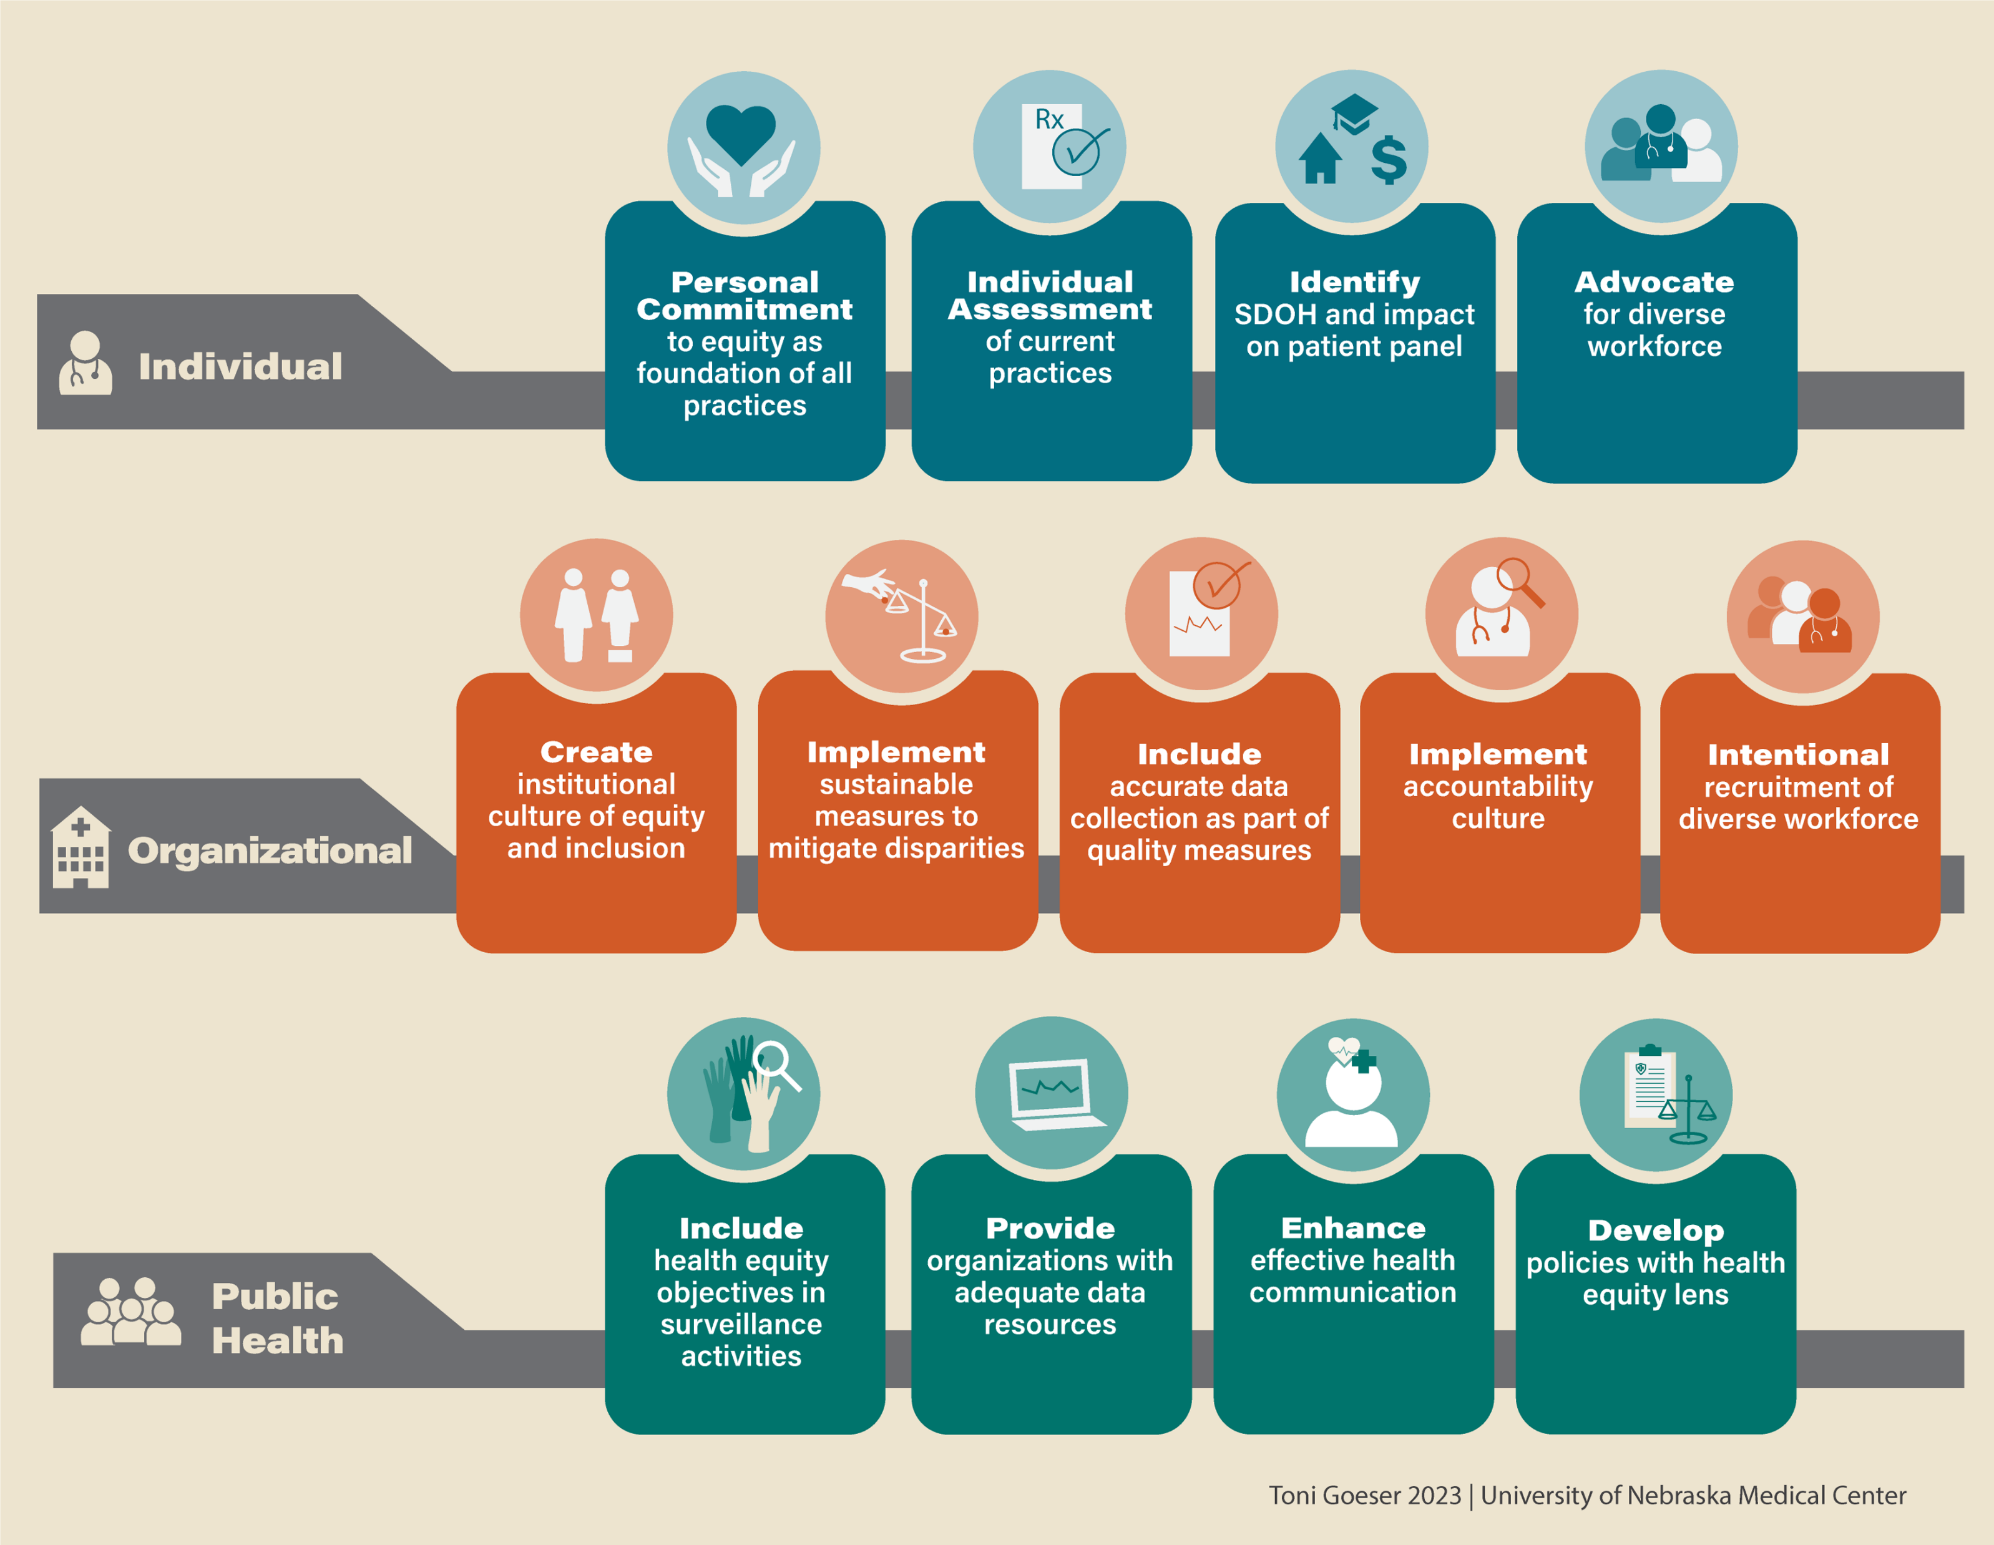
Actions for individuals, institutions, and public health organizations to mitigate impacts of health inequities.
https://www.cambridge.org/core/journals/infection-control-and-hospital-epidemiology/article/advancing-health-equity-through-action-in-antimicrobial-stewardship-and-healthcare-epidemiology/E500CD36798BF6BF7661F5223E4AFDF6

Slide 19
HAIs
Healthcare-associated infections (HAIs) are infections acquired during hospital stay that typically present after 48 hours of hospital admission
Most common types of HAIs include:
central line-associated bloodstream infections (CLABSI)
catheter-associated urinary tract infections (CAUTI)
surgical site infections (SSI)
ventilator-associated pneumonia (VAP)

Slide 20
Literature reviews shows inequities
A chart review of 79,019 all-payer hospital adult patients by Bakullari et al. concluded that Asian and Hispanic patients experienced significantly higher rates of catheter-associated urinary tract infections (CAUTI) than non-Hispanic White patients (5.0% and 4.6% vs. 3.2%, respectively)
Gualandi et al. found that Black patients had higher incidence rates of hospital-onset MRSA infection than White patients (6.21 per 100,000 vs. 2.94 per 100,000)
Source: https://www.ncbi.nlm.nih.gov/pmc/articles/PMC8390539/

Slide 21
Question for class discussion
What are some of the long-term impacts these patients may see from having these HAIs?
Are patients out of work longer?
More prescription medications needed?
Do these additional medications cause other health issues?
Additional medical bills?

Slide 22
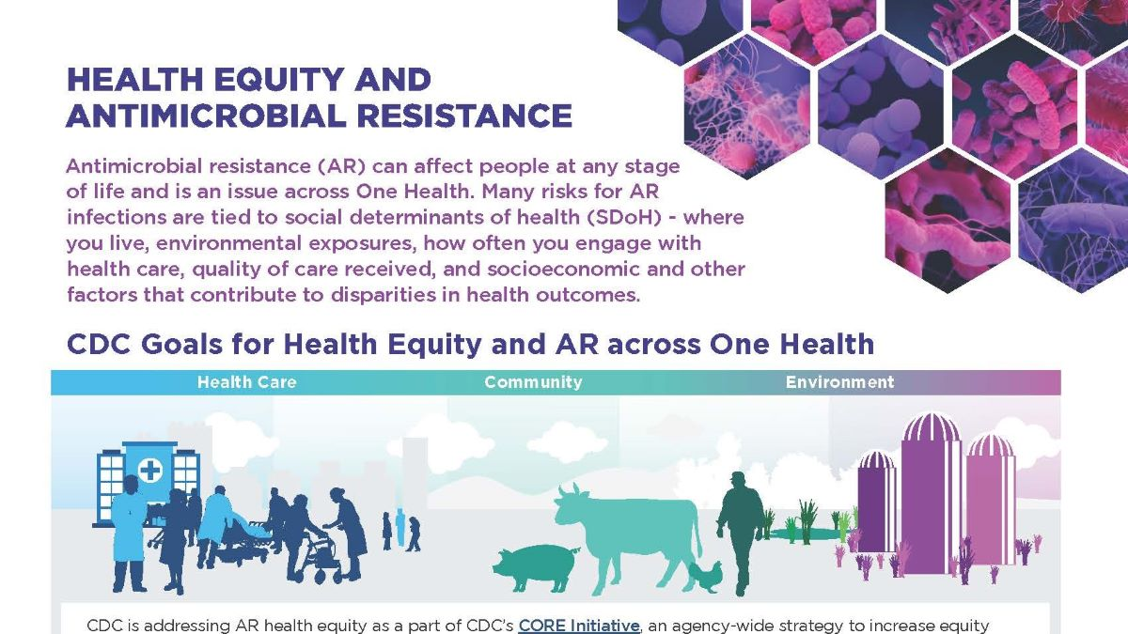

Slide 23
Question for class discussion
How do these inequities affect antimicrobial resistance?

Slide 24
Video resource on antibiotic resistance
CDC met with experts to discuss opportunities to reduce health disparities through strengthening antibiotic stewardship, including identification of risk factors that can contribute to health inequity and how to help healthcare providers improve prescribing practices.
https://www.cdc.gov/antimicrobial-resistance/stories/reducing-health-disparities.html
Video is available at: https://youtu.be/oL0vv0ODuMw

Slide 25
Additional CDC materials available on antimicrobial resistance
https://www.cdc.gov/antimicrobial-resistance/stories/ar-health-equity.html

