Slide 1
Infection Control and Prevention in Healthcare
A Health Policy and Management Perspective

Slide 2
Discussion Questions
Balancing Individual Rights and Public Health: How can healthcare institutions strike a balance between protecting individual privacy and ensuring effective infection control measures in the context of public health emergencies?
Healthcare Worker Safety: What policies and protocols should be in place to safeguard healthcare workers from infectious diseases while providing patient care? How can these policies be effectively enforced?
Antibiotic Stewardship: How can public health policies promote responsible antibiotic use to prevent the emergence of drug-resistant pathogens? What role do healthcare facilities play in implementing stewardship programs?
Surveillance and Reporting: How can healthcare systems collaborate with public health agencies to enhance surveillance of infectious diseases? What challenges exist in reporting accurate data promptly?
Outbreak Preparedness and Response: What strategies should healthcare organizations adopt to prepare for and respond to outbreaks (e.g., pandemics, nosocomial infections)? How can public health agencies support these efforts?

Slide 3
Discussion Questions
6. Health Equity and Infection Control: How do socioeconomic disparities impact infection control practices? What policies can address these disparities and ensure equitable access to preventive measures?
7. Vaccination Policies: How can healthcare facilities and public health authorities work together to promote vaccination coverage? What ethical considerations arise when enforcing vaccination mandates?
8. Infection Control in Long-Term Care Settings: What policies should be in place to prevent infections in nursing homes and other long-term care facilities? How can public health agencies collaborate with these institutions?
9. Global Health Security: How can international cooperation enhance infection control efforts? What policies can facilitate information sharing, resource allocation, and rapid response during global health crises?
10. Cost-Effectiveness of Infection Control Measures: How can healthcare administrators evaluate the cost-effectiveness of infection control interventions? What role does public health policy play in resource allocation for prevention and control?

Slide 4
Objectives
Understand the significance of infection control
Explore policies influencing infection prevention and control
Analyze the role of health management in infection control

Slide 5
Health Policy
Evidence-based health policies can help prevent disease and promote health.
For example, smoke-free policies can help prevent smoking initiation and increase quit attempts.
  Raising the age to purchase tobacco
Similarly, policies requiring community water systems to provide fluoridated water can improve oral health.
Establishing informed policies is key to improving health nationwide.

Slide 6
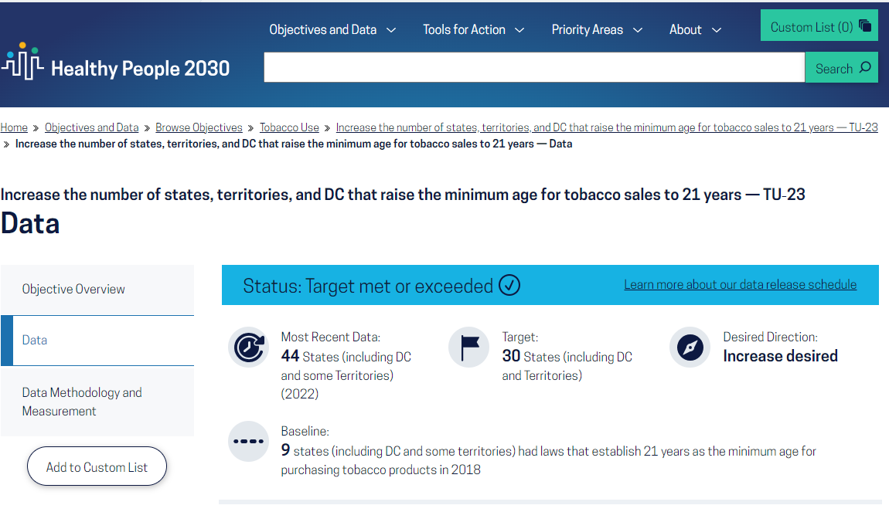
Examples https://health.gov/healthypeople/objectives-and-data/browse-objectives/tobacco-use/increase-number-states-territories-and-dc-raise-minimum-age-tobacco-sales-21-years-tu-23

Slide 7
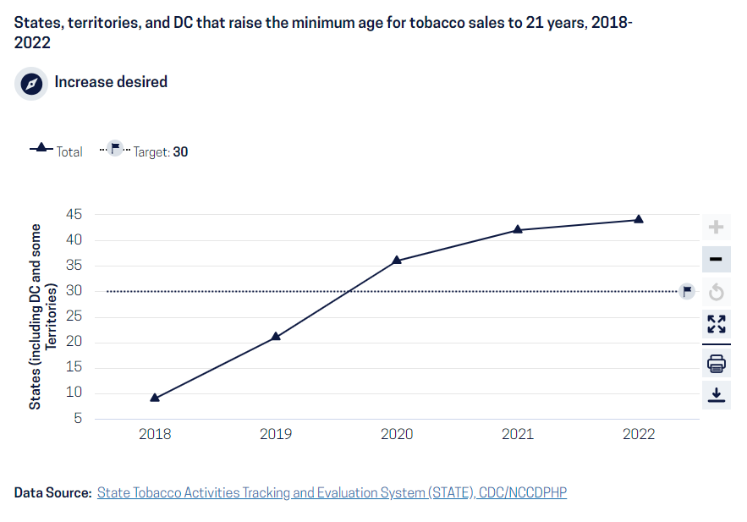

Slide 8
The Importance of Infection Control and Prevention in Healthcare
When a patient comes for medical treatment, they should not end up in a worse condition than when they arrived.
Infection prevention and control (IPC) is the aspect of health care which aims to ensure that patients do not contract infections as a result of attending a health care facility for assessment, examination, or treatment.
These are known as health care-associated infections (HAI’s).
The basic principles of infection control have been known for centuries, but prevention of health care-associated infections is still a major challenge.

Slide 9
The Importance of Infection Control and Prevention in Healthcare
Infection prevention and control (IPC) is a practical, evidence-based approach preventing patients and health workers from being harmed by avoidable infections.
Effective IPC requires constant action at all levels of the health system, including policymakers, facility managers, health workers and those who access health services.
IPC is unique in the field of patient safety and quality of care, as it is universally relevant to every health worker and patient, at every health care interaction.

Slide 10
Infection Prevention and Control
Defective IPC causes harm and can kill. Without effective IPC it is impossible to achieve quality health care delivery.
Infection prevention and control effects all aspects of health care, including
  Hand hygiene,
  Surgical site infections,
  Injection safety,
  Antimicrobial resistance and
  How hospitals operate during and outside of emergencies.
Programs to support IPC are particularly important in low- and middle-income countries, where health care delivery and medical hygiene standards may be negatively affected by secondary infections.(1)

Slide 11
Connection to health policy and management
The primary purpose of infection control programs is to focus on the surveillance for HAI’s and in-cooperate the basic understandings of epidemiology to understand risk factors for HAIs
Most infection control programs were organized and managed by large academic centers rather than public health agencies which lead to sporadic efficiency and suboptimal outcomes. (2)

Slide 12
Historical
It was not until the late 19th and early 20th century when the new era in infection control was started through three pivotal events.
These events included:
The Institute of Medicine’s 1999 report on errors in health care (https://nap.nationalacademies.org/resource/9728/To-Err-is-Human-1999--report-brief.pdf )
2002 Chicago Tribune representation on HAIs (https://www.chicagotribune.com/2002/07/21/infection-epidemic-carves-deadly-path/ )
2004/2006 publications of the significant reductions in bloodstream infection rate through the standardization of central venous catheter insertion process

Slide 13
Historical
This new era in healthcare epidemiology is characterized by consumer demands for more transparency and accountability, increasing scrutiny and regulation, and expectations for rapid reductions in HAIs rates
The role of infection control is to prevent and reduce the risk for hospital-acquired infections.
This can be achieved by implementing infection control programs/policies in the forms of surveillance, isolation, outbreak management, environmental hygiene, employee health, education, and infections prevention policies and management. (2)

Slide 14
Infection Control and Prevention Defined
Infection control program has the main purpose of preventing and stopping the transmission of infections.
Specific precautions are needed to prevent infection transmission depending on the microorganism.
The following are examples of indications for transmission-based precautions:
Standard precautions: Used for all patient care. It includes hand hygiene, personal protective equipment, appropriate patient placement, clean and disinfects patient care equipment, textiles and laundry management, safe injection practices, proper disposal of needles and other sharp objects.

Slide 15
Define Infection Control and Prevention
Contact precaution: Used for patients with known or suspected infections that can be transmitted through contact.
For those patients, standard precautions are needed, plus limit transport and movement of patients, use disposable patient care equipment, and thorough cleaning and disinfection strategies.
Patients with acute infectious diarrhea such as Clostridium difficile, vesicular rash, respiratory tract infection with a multidrug-resistant organism, abscess or draining wound that cannot be covered need to be under contact precautions.

Slide 16
Infection Control and Prevention
Droplet precautions: Used for patients with known or suspected infections that can transmit by air droplets through the mechanism of a cough, sneeze, or by talking.
In such cases, it is vital to control the source by placing a mask on the patient, use standard precautions plus limitation on transport and movement.
Patients with respiratory tract infection in infants and young children, petechial or ecchymotic rash with fever, and meningitis are placed under droplet precautions.

Slide 17
Infection Control and Prevention
Airborne precautions: Use for patients with known or suspected infections that can be transmitted by the airborne route.
Those patients require to be in an airborne infection isolation room with all the previously mentioned protections.
The most important pathogens that need airborne precautions are tuberculosis, measles, chickenpox, and disseminated herpes zoster.
Patients with suspected vesicular rash, cough/fever with pulmonary infiltrate, maculopapular rash with cough/coryza/fever need to be under airborne precaution.

Slide 18
The Importance of Policy in HAI/AR Prevention and Control
Many of the most effective and sustained examples of public health success are supported by effective policies.
Recent experiences with emerging and highly infectious diseases like COVID-19 further highlight the need for clarity and consistency in public health and health policy.
CDC works to identify policy options and best practices to support healthcare-associated infections and antimicrobial resistance (HAI/AR) prevention and improve healthcare outcomes.

Slide 19
The Importance of Policy in HAI/AR Prevention and Control
State policies are highly variable: in some cases, the variation is necessary to accommodate local needs and resources; in others, the variation is less useful and can lead to local gaps in patient protection across healthcare settings, and particularly across jurisdictions.
Greater consistency and harmonization of key policies could improve patient protection nationwide.
Additionally, healthcare surveillance data could be made more consistent and actionable across jurisdictions to allow local authorities to move toward seamless patient protection nationally.
Agreeing upon and applying basic standards for event reporting and infection control at local, state, and federal levels will provide a better path to improved patient safety and save lives.
(3)

Slide 20
Not all infections occur in hospitals
Outpatient Policy Options
The Outpatient Settings Policy Options [PDF – 37 pages] document and accompanying worksheet [PDF – 5 Pages] are designed to assist state, local, and territorial health departments and policymakers to assess current outpatient policies and consider options for improving practices. The document outlines four key elements recommended by the workgroup and reflect CDC, workgroup membership, and health department experience with healthcare-related outbreaks and quality improvement. Each section contains:
An explanation of the element and its components
Sample scenarios highlighting the need for effective practices or strategies
Potential program improvement options
Examples of existing policies representative of the elements
Aids designed to help identify gaps and pursue potential solutions

Slide 21
CDC and ASTHO Policy Toolkit for Healthcare-associated Infection Prevention
The Association of State and Territorial Health Officials (ASTHO) and CDC have collaborated since July 2010 to advance health departments’ HAI prevention efforts.
ASTHO and CDC created a toolkit and companion report to provide guidance to senior policy makers on promising ways to use legal and policy interventions as tools in implementing a comprehensive HAI prevention program.
The toolkit, Eliminating Healthcare Associated Infections: State Policy Options [PDF – 38 Pages]provides an inventory of state HAI legislation and examples of legal and policy interventions, which health officials can consider to facilitate HAI prevention.
State policies can promote robust state HAI programs and complement federal payment incentives such as CMS’s Value Based Purchasing program.

Slide 22
Importance of Infection Control
What is the impact of having insufficient policies for infection prevention?

Slide 23
The economic burden of healthcare-associated infections
HAIs not only led to increased morbidity and mortality but also impose a significant financial burden on the health system
The estimated direct annual cost of treating HAIs in the United States ranges from $ 28.4 billion to $ 45 billion, resulting in a heavy burden on the public health system
Such infections are unnecessary adverse events because they can be avoided through proper healthcare worker behavior and adherence to evidence-based infection prevention procedures and guidelines
https://www.ncbi.nlm.nih.gov/pmc/articles/PMC9949640/#:~:text=HAIs%20not%20only%20led%20to,public%20health%20system%20%5B8%5D.

Slide 24
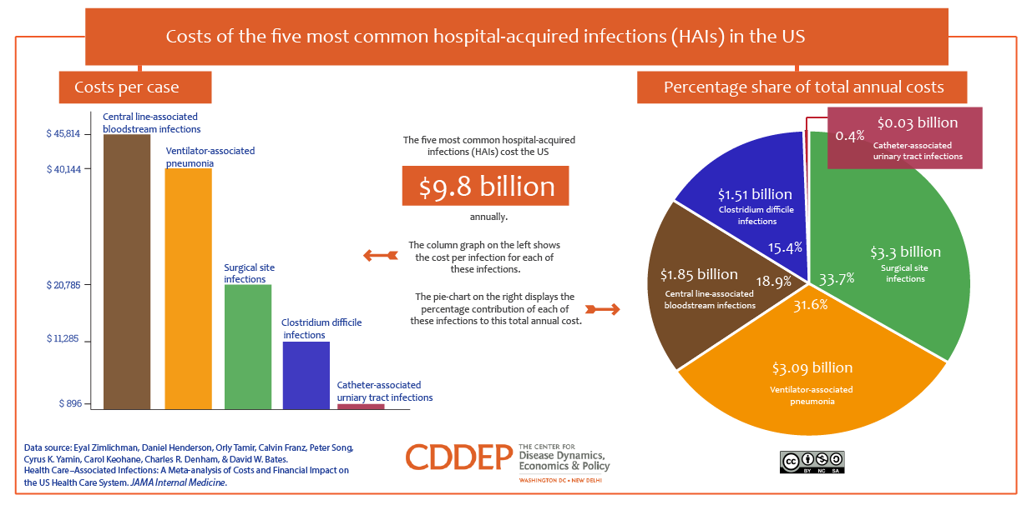

Slide 25
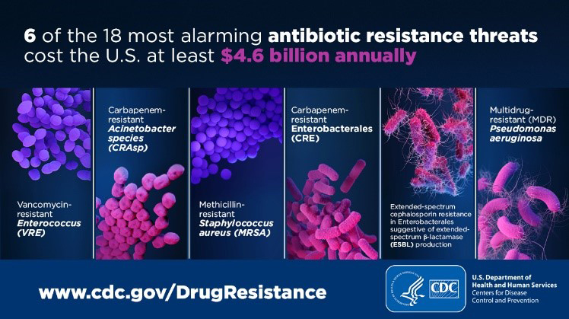

Slide 26
The role of infection control in improving patient outcomes
Without effective IPC it is impossible to achieve quality health care delivery.
Infection prevention and control effects all aspects of health care, including hand hygiene, surgical site infections, injection safety, antimicrobial resistance and how hospitals operate during and outside of emergencies

Slide 27
Regulatory Framework
Overview of regulatory bodies and policies related to infection control
Emphasize compliance and accreditation standards
Examples: CDC guidelines, WHO recommendations

Slide 28
Healthcare-Associated Infections (HAIs)
Healthcare-associated infections (HAIs) are infections people get while they are receiving health care for another condition. HAIs can happen in any health care facility, including hospitals, ambulatory surgical centers, end-stage renal disease facilities, and long-term care facilities.
The most common types of HAIs
  Central Line associated bloodstream infections (CLABSI’s)
  Catheter-associated Urinary Tract infections (CAUTI’s)
  Surgical Site infections (SSI’s)
  Ventilator-associated Pneumonia (VAPs)

Slide 29
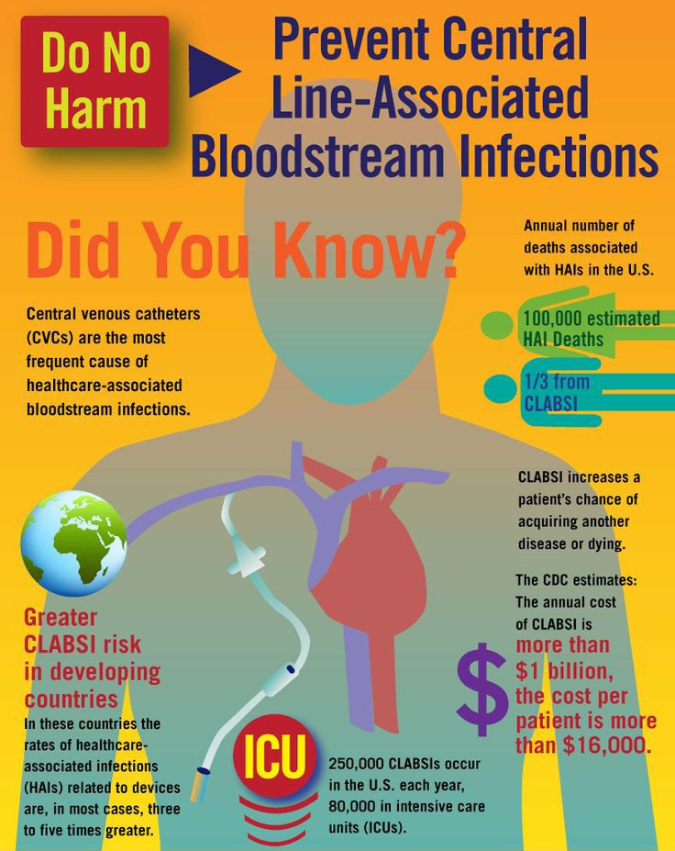
Central Line-associated Bloodstream Infection (CLABSI)
Central line-associated bloodstream infections (CLABSIs) result in thousands of deaths each year and billions of dollars in added costs to the U.S. healthcare system, yet these infections are preventable.
CDC is providing guidelines and tools to the healthcare community to help end CLABSIs.

Slide 30
Catheter-associated Urinary Tract Infections (CAUTI)
A urinary tract infection (UTI) is an infection involving any part of the urinary system, including urethra, bladder, ureters, and kidney.
UTIs are the most common type of healthcare-associated infection reported to the National Healthcare Safety Network (NHSN).
Among UTIs acquired in the hospital, approximately 75% are associated with a urinary catheter, which is a tube inserted into the bladder through the urethra to drain urine.
Between 15-25% of hospitalized patients receive urinary catheters during their hospital stay.
The most important risk factor for developing a catheter-associated UTI (CAUTI) is prolonged use of the urinary catheter.
Therefore, catheters should only be used for appropriate indications and should be removed as soon as they are no longer needed.

Slide 31
Surgical Site Infection (SSI)
A surgical site infection is an infection that occurs after surgery in the part of the body where the surgery took place.
Surgical site infections can sometimes be superficial infections involving the skin only.
Other surgical site infections are more serious and can involve tissues under the skin, organs, or implanted material.
CDC provides guidelines and tools to the healthcare community to help end surgical site infections and resources to help the public understand these infections and take measures to safeguard their own health when possible.

Slide 32
Ventilator-associated Pneumonia (VAP)
Ventilator-associated pneumonia is a lung infection that develops in a person who is on a ventilator.
A ventilator is a machine that is used to help a patient breathe by giving oxygen through a tube placed in a patient’s mouth or nose, or through a hole in the front of the neck.
An infection may occur if germs enter through the tube and get into the patient’s lungs.
CDC provides guidelines and tools to the healthcare community to help end ventilator-associated pneumonia and resources to help the public understand these infections and take measures to safeguard their own health when possible.
6

Slide 33
1. COVID-19 has hampered efforts to halt hospital-acquired infections
Prior to the COVID-19 pandemic, healthcare-associated infections had been decreasing since 2015, reports the Center for Infectious Disease Research and Policy (CIDRAP). However, the strain of COVID-19 patient care and triage on hospitals and other facilities “clearly put a dent in those efforts,” CIDRAP states.
During the last quarter of 2019 and second quarter of 2020, facilities were exempt from reporting HAIs. To gain insight into the impact of COVID-19 on hospital-acquired infections, the CDC’s National Healthcare Safety Network (NHSN) examined quarterly data from across 12 states. They found significant increases in central line associated bloodstream infections (CLABSIs), catheter-associated urinary tract infections (CAUTIs), ventilator-associated events (VAE), and MRSA bacteremia compared to 2019, including a 47% increase in CLABSIs across location types and a 65% increase in ICUs.
IPC programs have been overwhelmed by the pandemic, leaving many under-resourced and some pushing non-COVID HAIs onto the back burner. Hospitals need resilient, sustainable, and high-performing infection prevention and control programs more than ever.

Slide 34
2. These infections cost the healthcare system billions each year
According to the CDC, HAIs directly cost US hospitals at least $28.4 billion each year. These costs are underscored by a $12.4 billion loss to society from early deaths and lost productivity. Of the total amount, anywhere between $5.7 and $31.5 billion is possibly preventable.
The losses appear even more stark at the individual hospital level. A 2020 study published in BMC Health Services Research found that HAIs were associated with increased consumption of resources, including blood tests, imaging, hospital days, and antibiotic days. They were also associated with a higher cost per case at $6,400 vs. a control of $2,376.

Slide 35
3. Less than half of HAIs involve devices or surgeries
A study from the New England Journal of Medicine (NEJM) found that device-associated infections (such as CAUTI, ventilator-associated pneumonia, and CLABSI) made up 25.6% of all HAIs, while surgical-site infections accounted for 21.8% of HAIs. So, what caused the 52.6% of HAIs that were not associated with devices or operative procedures?
One pathogen stands out. The bacterium Clostridioides difficile accounts for 12.1% of HAIs, notes the NEJM study. C. difficile is easily spread from person to person and caused an estimated 223,900 HAI cases and 12,800 deaths in 2017, according to the CDC’s 2019 Antibiotic/Antimicrobial Resistance threat report.
C. difficile is resistant to multiple antibiotics used in clinical settings, including aminoglycosides, lincomycin, tetracyclines, erythromycin, clindamycin, penicillin, cephalosporins, and fluoroquinolones, according to research from the Journal of Clinical Microbiology. Treatment with antimicrobials significantly increases the risk of developing a C. difficile infection.

Slide 36
4. COVID-19 and Candida auris are the newest threats to watch
Aside from hospital-acquired SARS-CoV-2 infections, the pandemic has revealed several key developments that should be accounted for while planning for the future of infection control. Contact tracing for healthcare personnel with occupationally acquired COVID-19 is key for maintaining clinician safety and avoiding transmission to patients.
But COVID-19 isn’t the only relatively new risk. While tracking has been complicated by the pandemic, the CDC reports Candida auris is an increasing source of infections, especially from patients who have received care in other locations (domestic or international) that have higher C. auris transmission. This threat highlights the need to track and understand the direct impact community transmission has on your facility. Mortality rates can be significant: based on information from a limited number of patients, 30–60% of people with C. auris infections have died.
Infection control programs should be prepared to address surge capacity during COVID-19 and other outbreaks, as well as understand the impact of outbreak response on your existing HAI prevention and infection control processes, procedures, and outcomes.

Slide 37
5. HAIs happen outside hospitals
Successful infection control plans consider the risks of HAIs beyond the boundaries of the hospital. As the US population ages, more surgical procedures happen in outpatient settings, and antimicrobial resistance increases, infection control leaders should examine HAIs in three key areas:
Long-term care: The Pennsylvania Patient Safety Reporting System found a national infection rate of 1.07 infections per 1,000 resident days, with respiratory tract infections increasing between 2019 and 2020.
Outpatient surgery: Ambulatory surgery centers and outpatient settings frequently don’t have the luxury of dedicated infection control personnel, making oversight and prevention increasingly challenging.
Dialysis: Both patients and workers in hemodialysis settings are subject to increased risk of HAIs due to recurrent and prolonged blood exposure, proximity to other patients, and frequent hospitalization and surgery.
These challenges translate to a future of increased and specialized infection control and a need to rethink resources, research, and personnel dedicated to IPC efforts.

Slide 38
Strategies for Infection Prevention
Having established policies in place and an educated workforce
Hand hygiene
Personal protective equipment (PPE)
Follow respiratory hygiene/cough etiquette
Environmental cleaning (disinfect patient care equipment)
  Handle textiles/laundry carefully
Vaccination programs (facility and community based)
Ensure healthcare worker safety
Surveillance and monitoring

Slide 39
Health Policy in Infection Control
Discuss the role of government agencies
State and local health departments work with a number of federal agencies, primarily those within the U.S. Department of Health and Human Services. For example, the Centers for Disease Control and Prevention (CDC) leads efforts to control communicable disease outbreaks and promote mass immunization. The federal government also assists states with funding (when state resources are not available) and guidance for work such as emergency preparedness. At both the state and local level, Minnesota relies on these offices for grant funding and expertise.
4.

Slide 40
Explore how health policies influence infection prevention
IPC policies and guidelines have been found to enhance professional nurses’ experiences and understanding of infection control practices [16]. Effective IPC requires an understanding of HCWs [17]. IPC compliance is hindered by a lack of knowledge of the recommended practices, as well as by a lack of awareness of preventative reasons throughout routine patient care and the potential dangers of transmitting germs to patients [18,19]. Poor compliance is caused by ignorance about the suitability, effectiveness, and application of IPC procedures [20,21]. The keystones of enhancing IPC practices are training and education in order to overcome these obstacles [22]. HCWs need to understand the power of knowledge. Hence, knowledge and education of IPC measures play an important role in preventing infection among HCWs [22,23].
The knowledge of HCWs should cover topics such as hand washing, wearing private defensive equipment, vaccination for the preventative measures of infectious diseases, methods of spreading infection, spotting infections among patients, decontaminating medical devices, ability to handle hazardous material, and needle stick and sharp safety regulations. Even more crucially, HCWs must adhere to these IPC precautions, techniques, and approaches to guarantee the decrease in HAIs in hospital settings [20]. Edet et al. 2017 conducted a qualitative study which aimed to understand and explain behaviours that occur in everyday infection control practice from the perspective of healthcare workers. The study used vignettes developed from nurses’ account of practice in order to assess behaviours related to IPC. It has been discovered that workplace policies and infection monitoring improve professionals’ perceptions of IPC procedures as they concentrate on organisational aspects to create a favourable compliance orientation and create long-lasting IPC procedure methods [2].
5

Slide 41
Health Management in Infection Control
Role of healthcare managers in implementing infection control measures
Staff education and training
Resource allocation for infection prevention
Monitoring and evaluation of infection control programs

Slide 42
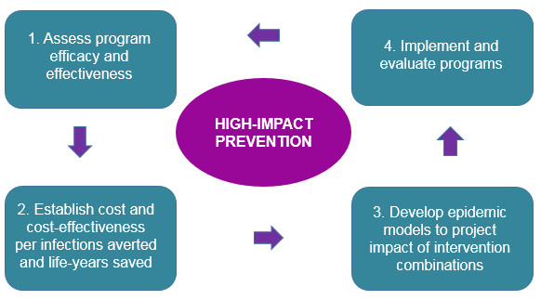
High Impact Prevention (HIP)

Slide 43
HIV Prevention Programs (Case Study)
CDC’s single largest investment in HIV prevention and a central component of its HIV prevention strategy is providing funding to health departments
The funding cycle that began in Fiscal Year (FY) 2012 represented a new direction in achieving a higher level of impact with every federal HIV prevention dollar.
Beginning in 2012, CDC ensured that prevention dollars were better matched to the HIV burden in every state, territory, and heavily affected city, and it focused on HIP.

Slide 44
Funding was directed to four core areas demonstrated to be high impact, as follows:
HIV testing;
Comprehensive HIV prevention with persons living with HIV, including antiretroviral therapy;
Condom distribution; and
Policy initiatives.
Additionally, ≤25% of core prevention funding could be used to support other proven-effective HIV activities, including evidence-based interventions for populations at high risk; social marketing, media, and mobilization; and pre- and post-exposure prophylaxis activities (not medications).

Slide 45
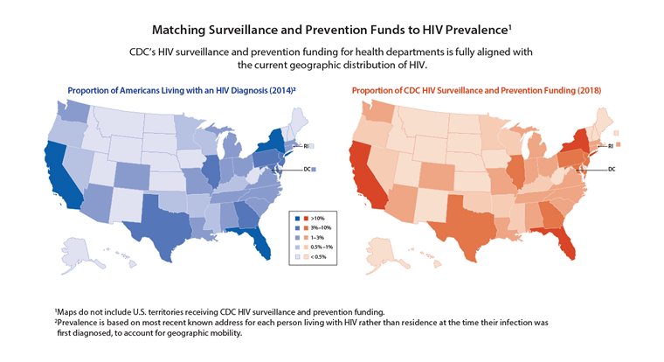
Results

Slide 46
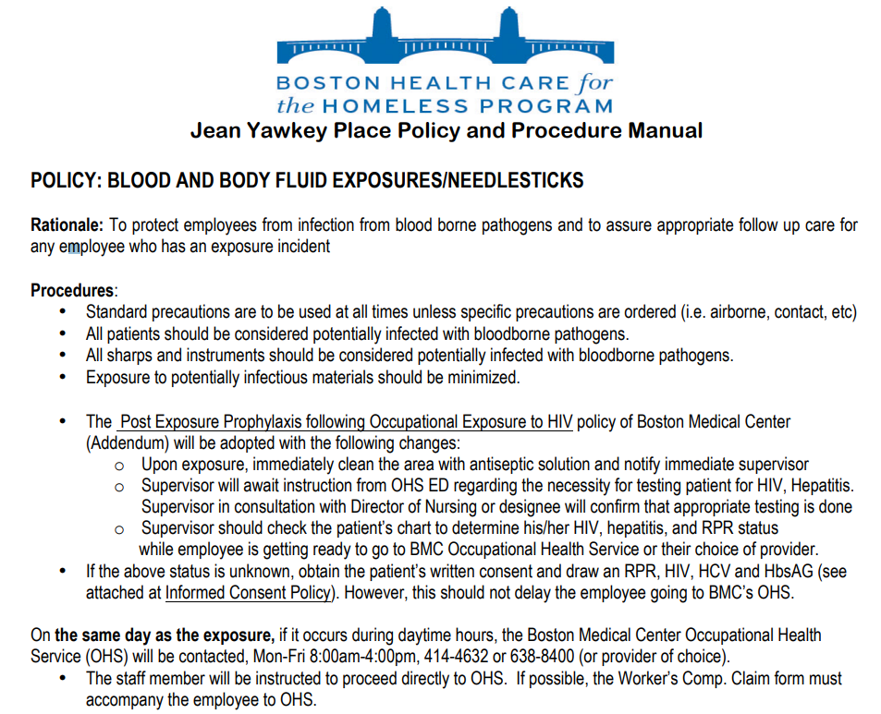

Slide 47
https://www.cdc.gov/infectioncontrol/guidelines/index.html
https://www.cdc.gov/sharpssafety/pdf/sharpsworkbook_2008.pdf
7

Slide 48
Challenges and Opportunities
Discuss challenges in implementing infection control measures
Explore opportunities for improvement
Importance of interdisciplinary collaboration

Slide 49
Future Trends
Emerging technologies in infection control
Innovations in healthcare management for infection prevention
Despite the cracks revealed by COVID-19, the future of hospital-acquired infection control and prevention is hopeful. By supporting and investing in resilient, sustainable, and high-performing IPC programs, infection control leaders can improve outcomes and decrease infection-related variability that hampers quality of care. This goal will require a focus on staff education, efficiency, and technology like electronic surveillance systems that align with your goals.

Slide 50
Electronic Hand Hygiene Monitoring Systems
Electronic hand hygiene monitoring systems (EHHMSs) offer hospitals large data sets of hand hygiene (HH) compliance among health care workers (HCWs) who wear their badges. Though the World Health Organization recommends direct observation of hand hygiene practices,¹ and though that remains the gold standard,² it is labor intensive, can be biased by the Hawthorne effect, and yields a much smaller denominator than EHHMSs provide. Limitations are inherent in all HH monitoring programs; however, the volume of data that EHHMs offers is of value to many IP programs. In addition to giving IP programs larger data sets of HH compliance, studies show that EHHMSs can increase HH compliance.^{3,4}
Despite the benefits of EHHMSs, barriers exist to widespread adoptability, including negative perceptions of the systems among HCWs,^{5,6} variability among the different types of systems,⁷ and an absence of studies demonstrating improvement in HAI outcomes with EHHMSs.⁸ Though HCWs routinely recognize the importance of HH and are generally positive about interventions to help improve compliance, Kelly et al found many HCWs worry about the accuracy of the data6 and may feel anxiety about the systems.⁵ In 2021 Knudsen et al found a statistically significant decrease in health care–associated bloodstream infections with improved HH in their small study,⁷ and Kovacs-Litman et al reported that hospital outbreaks occurred more often in units with lower HH compliance.⁹ These studies are encouraging and may lead to greater adoptability, particularly if future studies can reproduce similar results.

Slide 51
Antimicrobial Textiles
Despite mixed results in published studies, antimicrobial textiles (ATs) are
a promising technology for infection prevention. ATs uniquely decrease surface bioburden.¹⁰ Although little debate exists on the antimicrobial properties of copper and silver, the HAI prevention impact of impregnating fabrics or surfaces with these metals remains poorly defined.
Fan et al conducted a systematic review and meta-analysis in 2020 of 6 studies and did not find conclusive evidence that copper-impregnated linens decreased HAIs.¹¹ Albarqouni et al conducted an additional systematic review and meta-analysis of 7 studies in 2020 and found the same lack of evidence.¹² On a more promising note, Hesselvig et al demonstrated that iodine-impregnated incision drapes did reduce the contamination rate during primary knee arthroplasty compared with using no drape.¹³ This study does not answer the question of whether intraoperative contamination leads to a subsequent infection and, to date, no studies show a correlation. Madden et al found no decrease in HAIs following the introduction of copper-infused linens.¹⁰ However, Butler detected a statistically significant decrease in hospital-onset Clostridioides difficile infections in 2018 among patients in 6 different hospitals.¹⁴ The evidence is undeniably mixed.
An important consideration in the adoption of antimicrobial linens is wastewater management. These linens are more expensive than traditional hospital linens, so investigators must continue to study whether the savings hospitals may realize through reduction of HAIs through antimicrobial linens is worth the cost of purchasing them.¹⁵

Slide 52
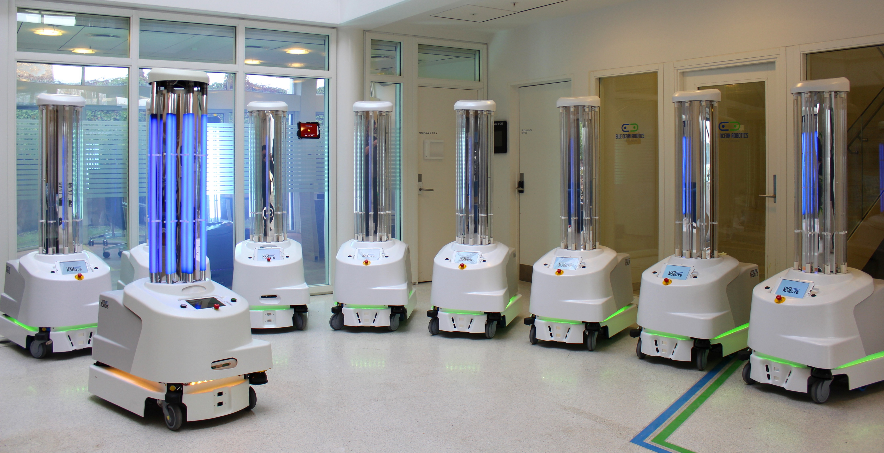
Ultraviolet C Devices
Much of the recent literature regarding UV-C robots discusses UV-C disinfection and SARS-CoV-2. In January 2022, Viana Martins et al reviewed 60 recent studies and found that UV-C devices inactivated airborne SARS-CoV-2, an important finding in the current fight against the COVID-19 pandemic.¹⁶ Although current rates of SARS-CoV-2 infections remain elevated as of this writing, focusing on preventing COVID-19 infections is crucial. Nonetheless, UV-C disinfection remains an important part of preventing many other infections in health care settings. The seminal study, the Benefits of Enhanced Terminal Room (BETR) Disinfection Study—a large, randomized 2016 control trial—found that “patients admitted to rooms previously occupied by patients harboring a multidrug-resistant organism or C difficile were [10% to 30%] less likely to acquire the same organism if the room was terminally disinfected using an enhanced strategy,” with the largest risk reduction occurring when a UV-C device was a part of the disinfection strategy.¹⁷ This study demonstrated that UV-C light could be used as part of the standard of care for disinfection in rooms where discharged patients have multidrug-resistant organism infections or C difficile infections, leading to a change in many health care facilities’ disinfection practices. In 2021, Rock et al found that UV-C disinfection did not decrease vancomycin-resistant enterococcus or C difficile infections in immunocompromised patients.¹⁸ Although this does not disprove the BETR study’s findings, Rock’s findings suggest that more research about the efficacy of UV-C disinfection in special populations is warranted.
Although UV-C devices can play a critical role in infection prevention programs, for them to provide optimum patient outcomes, health care facilities need a clear strategy for when the devices should be deployed. Like that of EHHMSs, the upfront cost of UV-C devices is significant, so a clear deployment plan helps to ensure the devices are used with consistency.

Slide 53
Optimization of the Electronic Medical Record for Infection Prevention Practices
As EMRs continue to become tools not just for clinician documentation, but also as data collection tools, harnessing the power of EMRs to prevent HAIs becomes increasingly important. Two innovative ways EMRs are being used in this capacity are decision-support tools, helping guide clinicians to make decisions to prevent HAIs; and predictive modeling via machine learning, aiding clinicians and infection programs in targeting patients at greatest risk of developing an HAI.
Decision-support tools are electronic nudges or hard stops that either direct clinicians away from choosing an intervention that may increase the risk of an HAI or disallow a clinician to make that choice at all (typically with an override from a hospital epidemiologist or other hospital leader). Recent studies continue to affirm that electronic nudges improve patient safety by decreasing inappropriate C difficile orders,¹⁹ increasing appropriate C difficile prescriptions,²⁰ and decreasing inappropriate antibiotic prescribing.²¹ However, decision-support tools are most likely to be effective when they feel easy to use, useful for decision-making, and reliable.²²
Preventing infections in hospitalized patients via predictive modeling using machine learning (ML) is still a novel field, but teams of investigators, clinicians, and information technologists are working to create tools that can be broadly adapted to help identify patients who are at greatest risk of developing an HAI. Multiple recent studies demonstrate promising results of a variety of predictive tools to assess who is at greatest risk of a central line–associated bloodstream infection,²³ ventilator-associated pneumonia (VAP),^{24,25} C difficile infections,²⁶ and catheter-associated urinary tract infections.^{27,28} Two of these studies found that the models they created outperformed more traditional regression models.^{26,28} However, Frondelius et al found fewer positive results in their systematic review of the literature looking at predictive modeling tools and their ability to prevent VAP.²⁹ A limitation to these tools being used regularly and as part of standard infection prevention practice is their newness. More testing and validation must be done before ML can be used to predict at-risk patients consistently and reliably, especially on a large scale. What works at 1 facility must be further validated for other facilities to use the same tool. Extracting correct data from the EMR remains an ongoing challenge at many health care facilities.

Slide 54
Conclusions
Summarize key points
Reiterate the importance of infection control in healthcare policy and management
Advances in infection prevention generally increase patient safety and decrease hospital costs. The role of infection prevention technologies is evolving. Future studies are required to explore the integration of infection prevention technologies into everyday practice. These investigations should focus on the validation of current technologies, particularly focusing on patient-centered outcomes such as HAI risk reduction. In addition, cost-benefit analyses are required for a better understanding of the potential impact of these technologies on the patient safety mission.

Slide 55
Questions

Slide 56
1. https://www.who.int/health-topics/infection-prevention-and-control#tab=tab_1
2. Habboush Y, Yarrarapu SNS, Guzman N. Infection Control. [Updated 2023 Sep 4]. In: StatPearls [Internet]. Treasure Island (FL): StatPearls Publishing; 2024 Jan-. Available from: https://www.ncbi.nlm.nih.gov/books/NBK519017/
3. https://www.cdc.gov/hai/hai-ar-programs/resources/policymakers.html
4. https://www.health.state.mn.us/communities/practice/resources/chsadmin/mnsystem-responsibility.html#:~:text=Federal%20influences,outbreaks%20and%20promote%20mass%20immunization.
5. Abalkhail A, Alslamah T. Institutional Factors Associated with Infection Prevention and Control Practices Globally during the Infectious Pandemics in Resource-Limited Settings. Vaccines (Basel). 2022 Oct 27;10(11):1811. doi: 10.3390/vaccines10111811. PMID: 36366320; PMCID: PMC9696365.
6 https://www.cdc.gov/hai/infectiontypes.html#:~:text=These%20healthcare%2Dassociated%20infections%20(HAIs,known%20as%20surgical%20site%20infections.
7. https://www.cdc.gov/infectioncontrol/index.html

